Slide 1
Class base views vs function base views

Slide 2
Template View

Slide 3
Template View
show index.html with function and class based
In Django doc use templateview
See parents of templateview
https://docs.djangoproject.com/en/4.2/topics/class-based-views/
https://docs.djangoproject.com/en/4.2/ref/class-based-views/base/#django.views.generic.base.TemplateView

Slide 4
Redirect View

Slide 5
Redirect View
https://docs.djangoproject.com/en/4.2/ref/class-based-views/base/#django.views.generic.base.RedirectView

Slide 6
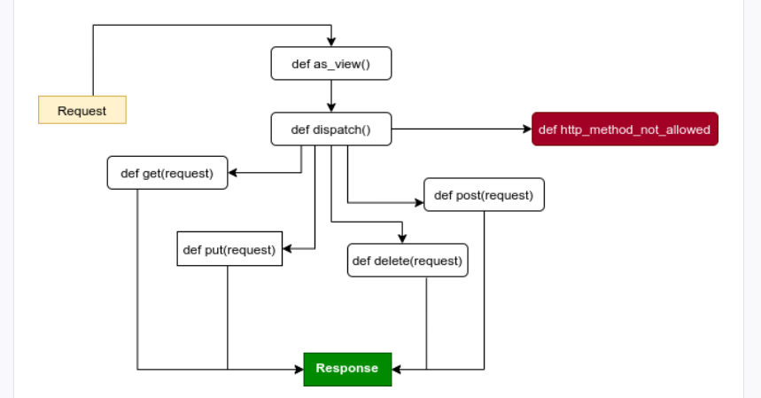
Class bases views flowchart

Slide 7
List View

Slide 8
